Slide 1
PSYC 2012
Week 15: Emotion Disorders & Intro to Pharmacology

Slide 2
Goals of This Week’s Lectures:
To learn about anxiety and mood disorders and what brain changes are associated with them and to begin to learn about drugs and how they affect the nervous system

Slide 3
Anxiety:
A negative emotional state in which feelings of nervousness, worry, and apprehension are associated with increased arousal of the body

Slide 4


Two Components of Anxiety
Cognitive anxiety—psychological thoughts and feelings of nervousness, worry, or apprehension--The locus coeruleus of the reticular activating system
Somatic anxiety—the physiological symptoms of higher arousal associated with anxiety, including increased heart rate, increased breathing, sweating, etc.—sympathetic nervous system
A little anxiety is normal and even beneficial, if it helps you to anticipate and prepare for a future stressor

Slide 5
Anxiety can be temporary or more permanent
State anxiety—a temporary emotional state or mood characterized by cognitive and somatic symptoms of anxiety
Trait anxiety—a component of personality, or predisposition that influences behavior so that individuals high in trait anxiety is more likely to perceive circumstances as threatening
Anxiety disorder—a conditon characterized by chronic feelings of excessive worry and anxiety without a specific or rational cause that has a negative impact on a person’s life

Slide 6
Key Point:
State anxiety can change for a given person from moment to moment

Slide 7
Key Point:
Trait anxiety can cause two people to differ dramatically in their state anxiety response to a given situation

Slide 8

Symptoms of Anxiety
Affective Symptoms--unpleasant feelings such as uncertainty, feeling overwhelmed, guilt, nervousness
Cognitive Symptoms—recurrent negative thoughts, obsessions or compulsions, irrational fears
Behavioral Symptoms—avoidance of situations, panic attacks, compulsive behaviors
Somatic Symptoms—muscle tension, increase HR, excessive sweating, etc.

Slide 9
Key Point:
Patients with clinical anxiety are distinguished from those with “normal” anxiety by the number and intensity of symptoms, degree of suffering, and degree of dysfunction—when the anxiety response occurs in the absence of an eliciting event, is disproportionate, and unmanageable

Slide 10
Neurbiological Changes in Anxiety

Slide 11
The Emotion Circuit and Anxiety
The ventromedial prefrontal cortex (vmPFC)-inhibits negative emotional responses; size or activity of the vmPFC is decreased in patients with anxiety disorders
The cingulate cortex--threat & conflict assessment; size and/or activity of the CC is increased in patients with anxiety disorders
Insular cortex—interoceptive/body awareness cues—activity can be increased in patients with anxiety disorders
Amygdala—assesses emotional salience and activates stress/emotional responses; activity or size of the amygdala can be increased in patients with anxiety disorders
The locus coeruleus, HPA, and SNS produce cognitive and somatic arousal and they too can be overly active in anxious subjects
Sensory Association Cortex
Insula
VentromedialPrefrontal Cortex
Cingulate Cortex
Reward
Centers
-
+
+
-
Amygdala
Hypothalamus
HPA
Brain stem
SNS
LC

Slide 12
Neural Basis of Anxiety
The amygdala is involved with transmitting fear signals to the hypothalamus and activating the SNS and the HPA axis
People with an anxiety disorder may have either elevated excitatory gluamatergic input to the amygdala OR decreased inhibitory GABAergic input
Amygdala neurons can also increase in dendritic branching for excitatory inputs in anxiety sufferers
Anxiolytic drugs like benzodiazepines increase GABA signaling and reduce amygdala activation of the hypothalamus
Glutamate
neuron
GABAergic
neuron
Glutamate
neuron
GABAergic
neuron
OR
+
-
+
-
Amygdala neuron
Amygdala neuron
+++
+
Hypothalamic neuron
Hypothalamic neuron
HPA
SNS
HPA
SNS
Normal Person
Person w/Anxiety
Disorder

Slide 13
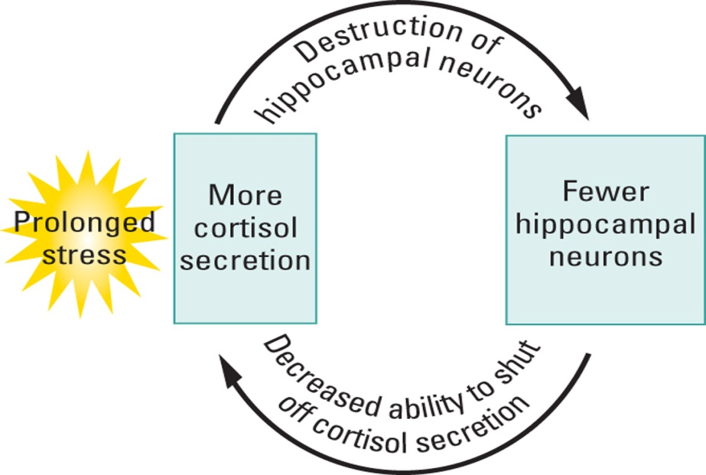
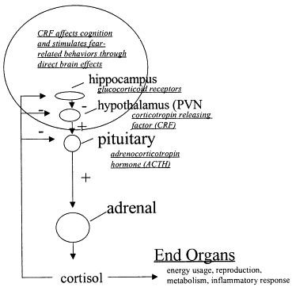
Stress Pathways & Anxiety Disorders
People with anxiety disorders have a greater reaction to stressors than normal people
Exposure to severe or chronic childhood stress results in death of hippocampal neurons due to high levels of cortisol as well as decreased dendritic branching of hippocampal neurons
Hippocampal neurons are critical for inactivating the stress response
Loss of hippocampal neurons and decreased dendritic branching decreases the ability of the hippocampus to turn off the stress response

Slide 14
What Can Cause Anxiety Disorders?

Slide 15
Depression

Slide 16


“State” vs. “Trait” Depression
“State” depression—everyone gets depressed occasionally, often in association with a negative life event such as a death of a loved one or loss of a job
“Trait” depression—a personality trait characterized by low mood, excessive negativity, etc.
Mood Disorder—a lifelong mental disorder characterized by low mood, loss of interest in pleasurable activities, etc.

Slide 17

Symptoms of Depression
Affective Symptoms—anhedonia--loss of interest in most or all activities; feelings of sadness
Cognitive Symptoms—difficulty thinking or concentrating, irrationally negative assessments of most situations, memory problems, hallucinations, recurring thoughts of death and suicidal ideation—recurring thoughts and fantasies of killing one’s self, learned helplessness—when individuals stop trying to avoid negative situations and feel that negative states are inescapable
Behavioral Symptoms—psychomotor retardation—decreased physical/mental activity, avoidance of situations; attempted suicide
Somatic Symptoms—vegetative symptoms--sleep disturbances, appetite/body weight disturbances, high stress hormones

Slide 18
Potential Neurobiological Mechanisms Underlying Depression
Monoamine hypothesis—depression is caused by decreased levels of the neurotransmitters serotonin, norepinephrine, and/or dopamine
Neurotrophin hypothesis—depression is caused by decreased levels of neurotrophins such as BDNF

Slide 19
The Monoamine Hypothesis of Depression:
Serotonin, dopamine and norepinephrine

Slide 20
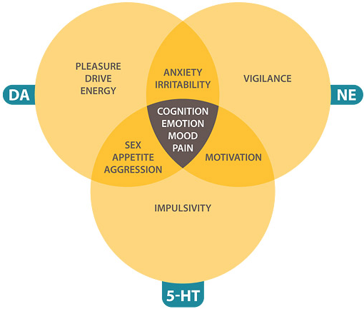
Monoamine Hypothesis
Serotonin—involved in sleep, eating, and mood, and depressed patients have mood problems as well as vegetative symptoms of sleep and eating disruptions
Dopamine—involved in pleasure & reward, and depressed patients have anhedonia or lack of pleasure
Norepinephrine (NE)—involved in arousal, and depressed patients have psychomotor retardation or lethargy and decreased arousal

Slide 21
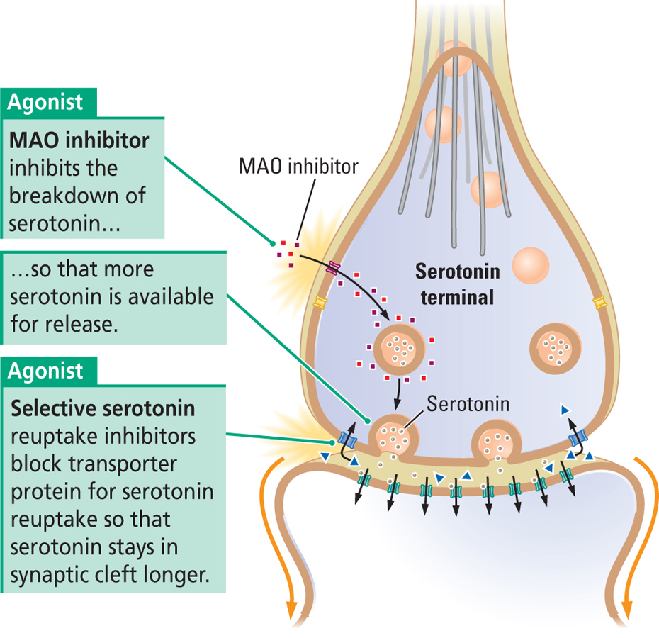
Evidence for the Monoamine Hypothesis
Decreases in serotonin, dopamine, and NE have been found in autopsy studies of brains of depressed patients
Genetic variations in the serotonin, dopamine, and/or NE are associated with greater risk of depression
Brain levels of the serotonin, dopamine, and NE are increased by SSRI and MAOi anti-depressants

Slide 22
Problems with the Monoamine Hypothesis
Anti-depressant medications are only effective for about 25-50% of depressed patients and are completely ineffective for about 20% of depressed patients even though the elevate monoamines
Monoamine depletion does not worsen symptoms in depressed patients not taking medication, nor does it cause depression in healthy volunteers with no depressive illness
The effects of many anti-depressant medications take weeks to improve depression even though monoamine levels increase almost immediately

Slide 23
Conclusion:
Disruptions of monoamine concentrations are not sufficient by themselves to produce depression, and probably are reflective of, or contribute to, some other mechanism

Slide 24
The Neurotrophin Hypothesis

Slide 25
Neurotrophins, Neurogenesis, and Depression
Neurotrophins such as BDNF promote long-term potentiation, dendritic branching, and hippocampal neurogenesis and neuronal survival
BDNF levels are decreased by stress/cortisol/inflammatory cytokines and are lower in depressed patients
Neurogenesis and dendritic branching are impaired and hippocampal size is decreased in depressed patients
Monoamine synaptic transmission increases BDNF release
Anti-depressants increase BDNF levels and increase dendritic branching and neurogenesis in the hippocampus, and blocking BDNF inhibits the beneficial effects of anti-depressants
Injection of BDNF alone decreases depression
Anti-Depressants
Monoamine
Signaling
Cortisol
-
BDNF Release
-
Pro-inflammatory cytokines
Greater health & survival of neurons
Disruptions in neurotrophin signaling
are a consequence of reduced monoamine
signaling and are the most primary and
proximal cause of depression

Slide 26
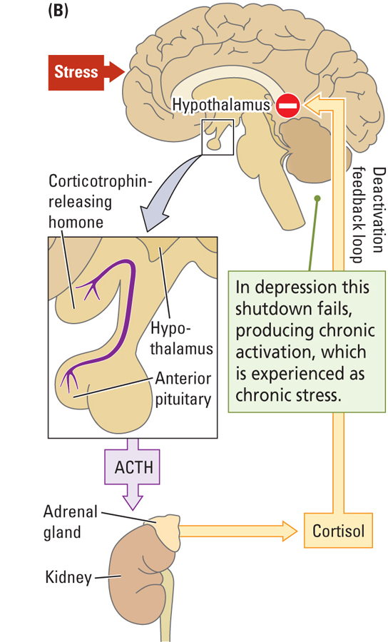
Stress and Depression
Exposure to chronic or severe stress kills hippocampal neurons, decreasing the ability to turn off the stress response
Early exposure to stress down-regulates cortisol receptors in hypothalamic neurons, causing these neurons to be further unable to turn off the stress response
Stress also seems to directly inhibit BDNF production in the hippocampus, decreasing LTP, dendritic branching, neurogenesis, and neuronal survival

Slide 27
Other Brain Regions Involved in Depression
Cingulate cortex—involved in appraisal of situations, error detection, threat, etc. Activity is greater in depressed patients
vm prefrontal cortex—brain area involved in decision making and attributions, the left PFC is involved with positive moods, the right PFC with negative moods; the left PFC is often smaller/less active and the right PFC is larger/more active in depressed patients
Amygdala—region of the limbic system involved in fear sensing and stress activation, involved in negative moods—more active in depressed patients
Sensory Association Cortex
Insula
VentromedialPrefrontal Cortex
Cingulate Cortex
Reward
Centers
-
+
-
Amygdala
Hypothalamus
HPA
Brain stem
SNS
LC

Slide 28
Psychoactive Drugs:
Any substance that alters mood, thought, or behavior

Slide 29
Psychopharmacology:
The scientific study of the actions of drugs and their effects on mood, sensation, thinking, and behavior

Slide 30
Psychoactive Drug Actions

Slide 31
Key Point:
Most psychoactive drugs influence synaptic transmission

Slide 32
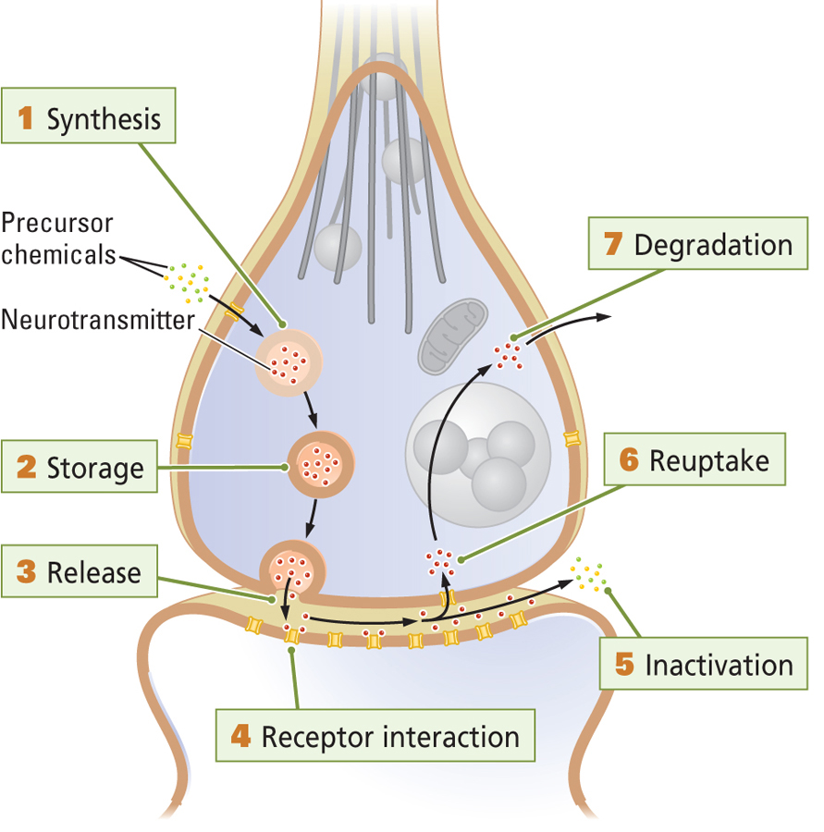
6 Main Sites of Drug Action
NT Synthesis—in cell body, axon, or terminal
NT Storage—transport into vesicles
NT Release—how many vesicles fuse per AP
Receptor activation
Inactivation/degradation
Reuptake

Slide 33
Key Point:
An agonist is any drug that increases neurotransmission, an antagonist is any drug that decreases neurotransmission

Slide 34
Key Point:
Both agonists and antagonists can work on any of the 6 sites of drug action

Slide 35
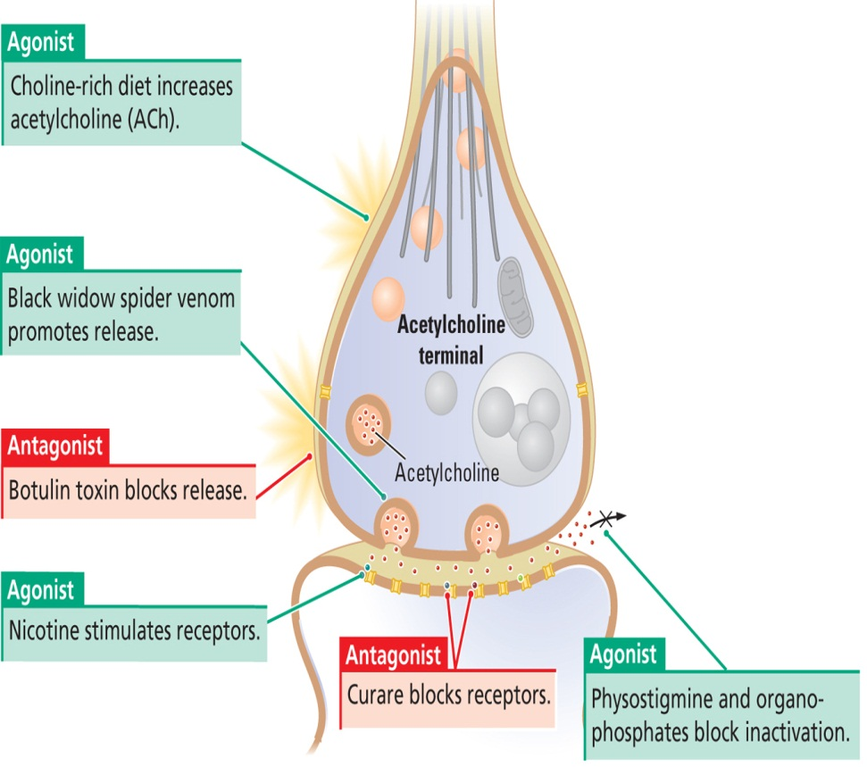
Examples of Agonists & Antagonists—Cholinergic System
Choline-poor diet—antagonist, decreases synthesis
Black widow spider venom—agonist, increases release
Botulinum toxin—antagonist, inhibits release
Nicotine—agonist, activates receptors
Curare—antagonist, blocks receptors
Physostigmine—agonist, blocks inactivation
Choline-poor diet
blocks synthesis

Slide 36
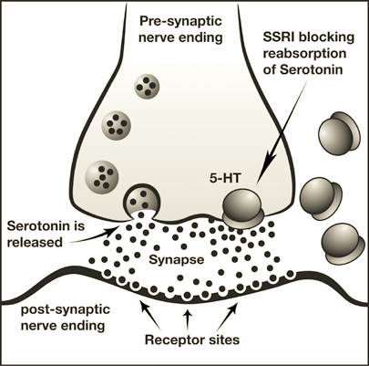
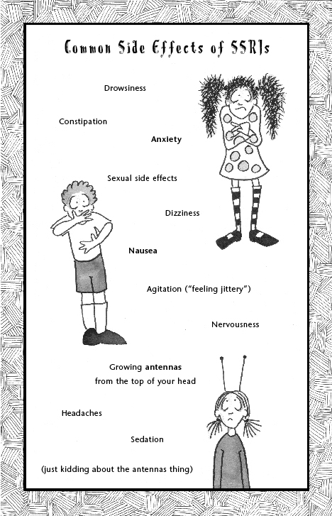
Side Effects
Additional physiological or psychological effects of a drug beside the one intended
Side effects often arise because neurotransmitters are used in many different places throughout the brain and body
Example: Selective serotonin reuptake inhibitors—prevent reuptake of serotonin after release into the synapse by serotonergic neurons
However, serotonergic neurons also project to brain areas regulating sleep and food intake so changes in arousal and appetite can also occur, and serotonin also influences gut motility so nausea can also be a side effect of SSRIs

Slide 37
Drug Removal

Slide 38
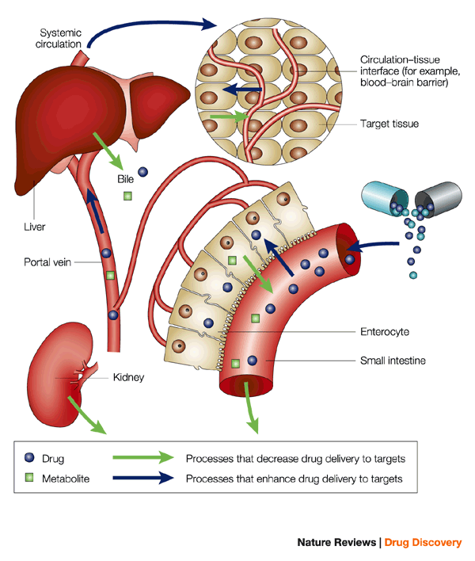
4 Main Ways of Drug Removal
Metabolism*--enzymatic breakdown of a drug by the liver or other bodily structures
Elimination*—removal from the system by kidneys, gut, etc.
Sequestration—dilution in fat or other cellular or fluid compartments of the body
Central degradation and uptake—by neurons or glia
*main ways

Slide 39
Drug Addiction

Slide 40
What is Drug Addiction?
Persistent use of a substance despite problems related to use of the substance

Slide 41




What are Some Characteristics of Addiction?

Slide 42
Tolerance
need to increase dosage just to maintain results

Slide 43
3 Main Types of Tolerance
Metabolic or pharmacokinetic—an increase in the breakdown or elimination of a drug by the body
Cellular or pharmacodynamic—response to the drug is decreased at the neuron
Behavioral or psychological—behavioral adaptations to the effects of a drug

Slide 44
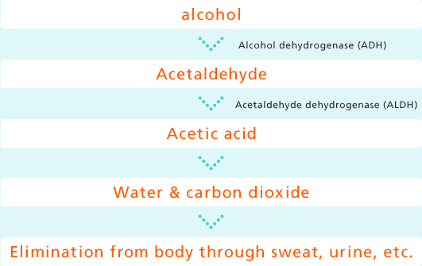
Metabolic Tolerance
Up-regulation of enzymes in the liver or other organs that degrade the drug or substance
Increased clearance via kidneys or gut
Example: alcohol dehydrogenase in alcoholics

Slide 45
Cellular Tolerance
Decreased post-synaptic receptor density—most common
Increased uptake or inactivation by neurons and glia
Decreased dendritic branching and/or synaptic number between affected neurons with chronic drug abuse
Cellular tolerance is a form of learning and memory

Slide 46
3 Types of Behavioral or Psychological Tolerance
Behavioral adaptation—ability to act unaltered by high levels of drug because of repeated use and familiarity with the effects of the drug
Learned tolerance—learning a task when under the influence of a substance improves performance of the task when under the influence of the substance
Environmental-dependent tolerance—a reduction in impairment if a drug is always administered in the same environment or is accompanied by the same cues

